Slide 1
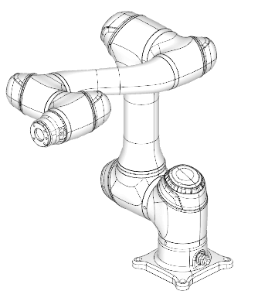
Forward Kinematics of COBOT

Slide 2
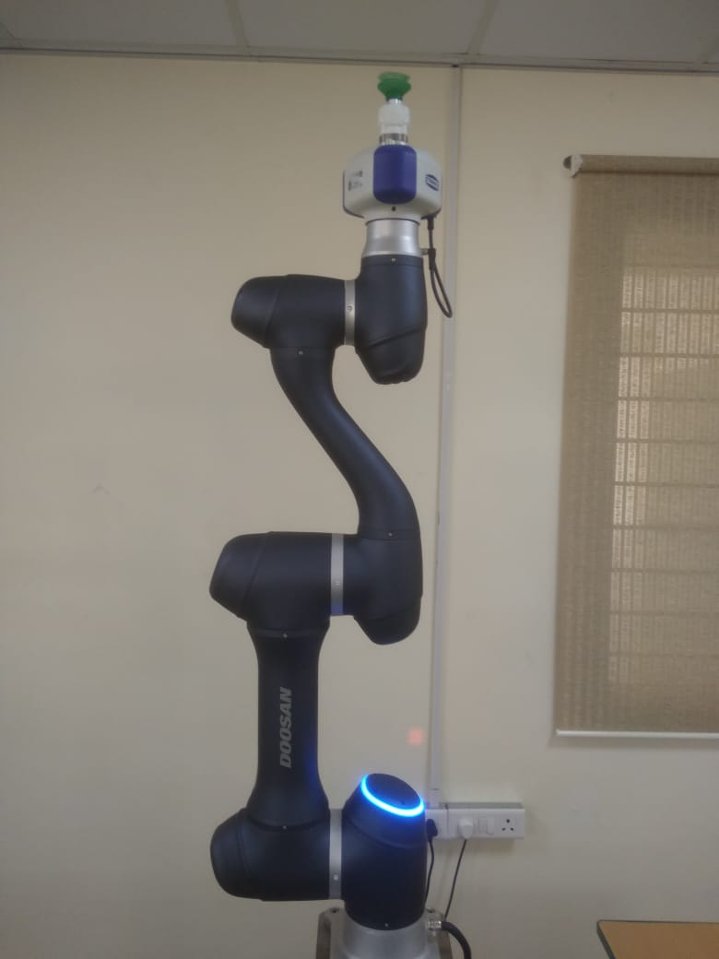
2nd Attempt on frames and DH
Z₆
190
X₆
Z₅
124
X₅
Same origin
Z₄
367
X₄
X₂
Link I | ai | Alpha i | di | theta i
1 | 0 | 90 | L1 | θ1
2 | L2 | 0 | 0 | 90+θ2
3 | 0 | -90 | 0 | -90+θ3
4 | 0 | 90 | L3 | θ4
5 | 0 | -90 | 0 | θ5
6 | 0 | 0 | L4 | θ6
1245.5
Z₃
900
Z₂
X₃
409
Z₁
155.5
Z₀
X₁
X₀

Slide 3
1st Attempt on frames and DH
Z₆
X₆
This is correct, but not the
one used in the actual Cobot’s sw.
190
Z₅
X₅
124
X₄
Same origin
Z₄
367
X₂
Link I | ai | Alpha i | di | theta i
1 | 0 | -90 | L1 | θ1
2 | L2 | 0 | 0 | -90+θ2
3 | 0 | 90 | 0 | 90+θ3
4 | 0 | -90 | L3 | θ4
5 | 0 | 90 | 0 | θ5
6 | 0 | 0 | L4 | θ6
1245.5
Z₃
X₃
900
Z₂
409
X₁
Z₁
155.5
Z₀
X₀

Slide 4



Θ1=pi/2; θ2=-15º, θ3=-60, θ4=θ5=θ6=0;
Old Model: New Model:
Given x=0;y=-763.65; z=726.82; Rx=90;Ry=-75;Rz=0
$\left[\begin{matrix}0 & −1 & 0 \\ .2588 & 0 & −.9659 \\ .965 & 0 & .2588\end{matrix}\right]$

Slide 5
